Slide 1
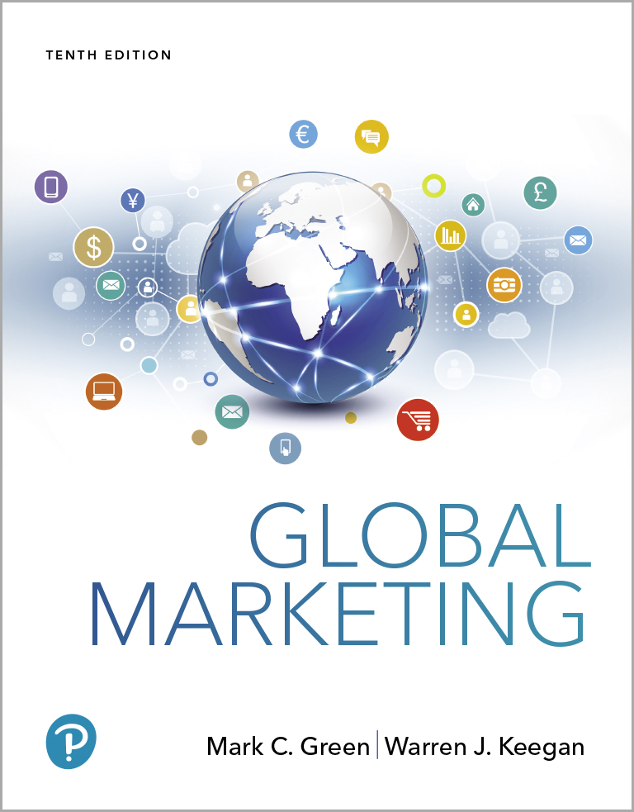
Global Marketing
Tenth Edition
Chapter 10
Brand and Product Decisions in Global Marketing
Copyright © 2020, 2017, 2015 Pearson Education, Inc. All Rights Reserved
Notes:
If this PowerPoint presentation contains mathematical equations, you may need to check that your computer has the following installed:
1) MathType Plugin
2) Math Player (free versions available)
3) NVDA Reader (free versions available)

Slide 2
Learning Objectives
10.1 Review the basic product concepts that underlie a successful global marketing product strategy.
10.2 Compare and contrast local products and brands, international products and brands, and global products and brands.
10.3 Explain how Maslow’s needs hierarchy helps global marketers understand the benefits sought by buyers in different parts of the world.
10.4 Outline the importance of “country of origin” as a brand element.
10.5 List the five strategic alternatives that marketers can utilize during the global product planning process.
10.6 Explain the new-product continuum and compare and contrast the different types of innovation.
Notes:
The product “P” of the marketing mix is at the heart of the challenges and opportunities facing global companies today: Management must develop product and brand policies and strategies that are sensitive to market needs, competition, and company ambitions and resources on a global scale. Effective global marketing often entails finding a balance between the payoff from extensively adapting products and brands to local market preferences and the benefits that come from concentrating company resources on relatively standardized global products and brands.

Slide 3
Basic Product Concepts
A product is a good, service, or idea
Tangible Attributes
Intangible Attributes
Product types
Consumer goods
Industrial goods
Notes:
A product’s tangible attributes can be assessed in physical terms such as weight, dimensions, or materials used. Consider, for example, a flat-panel TV with an OLED screen that measures 42 inches across. The unit weighs 20 pounds, is 2.2 inches thick, features four high-definition media interface (HDMI) connections, has a built-in tuner capable of receiving high-definition TV signals over the air, and delivers a 4K screen resolution.
Intangible product attributes, including status associated with product ownership, a manufacturer’s service commitment, and a brand’s overall reputation or mystique, are also important. When shopping for a new TV set, for example, many people want “the best:” They want a TV loaded with features (tangible product elements), as well as one that is “cool” and makes a status statement (intangible product element).

Slide 4
Product Warranties
An Express Warranty is a written guarantee that assures the buyer is getting what he or she paid for or provides a remedy in case of a product failure
Warranties can be used as a competitive tool to position a company in a positive way
Notes:
In the late 1990s, Hyundai Motor America chief executive Finbarr O’Neill realized that many American car buyers perceived Korean cars as “cheap” and were skeptical about the Hyundai nameplate’s reliability. In fact, the company had made significant improvements in the quality and reliability of its vehicles, but consumer perceptions of the brand had not kept pace with the changes. O’Neill instituted a 10-year, 100,000-mile warranty program that represents the most comprehensive coverage in the auto industry. Concurrently, Hyundai launched several new vehicles and increased expenditures for advertising. The results are impressive: Hyundai’s U.S. sales jumped from about 90,000 vehicles in 1998 to nearly 665,000 vehicles in 2017. Hyundai has also overtaken Toyota as Europe’s best-selling Asian car brand.

Slide 5
Packaging
Consumer Packaged Goods are a variety of products whose packaging protects or contains the product from production to the end user
Eco-packaging addresses environmental issues like recycling, biodegradability, & sustainable forestry
Must engage the senses, make an emotional connection, & enhance the brand experience
Examples: Absolut Vodka, Altoids breath mints, Godiva Chocolates, Corona Extra, Coca-Cola, Grey Goose, Aquafresh
Notes:
Brewers, soft drink marketers, distillers, and other beverage firms typically devote considerable thought to ensuring that packages speak to consumers or provide some kind of benefit beyond simply holding liquid. For example, a critical element in the success of Corona Extra beer in export markets was management’s decision to retain the traditional package design, which consists of a tall transparent bottle with “Made in Mexico” etched directly on the glass. At the time, the conventional wisdom in the brewing industry was that export beer bottles should be short, green or brown in color, with paper labels. In other words, the bottle should resemble Heineken’s! The fact that consumers could see the beer inside the Corona Extra bottle made it seem more pure and natural. Today, Corona is the top-selling imported beer brand in the United States, Australia, Belgium, the Czech Republic, and several other countries. Coca-Cola’s distinctive (and trademarked) contour bottle comes in both glass and plastic versions and helps consumers seek out the “real thing.” The bottle design, which dates back to 1916, was intended to differentiate Coke from other soft drinks.

Slide 6
Labeling
Attracts attention, supports product positioning, persuades consumers to buy
Provides consumers with various types of information
Regulations differ by country regarding various products
Health warnings on tobacco products
American Automobile Labeling Act clarifies the country of origin, and final assembly point
European Union requires labels on all food products that include ingredients from genetically modified crops
Notes:
One hallmark of the modern global marketplace is the abundance of multi-language labeling that appears on many products. In today’s self-service retail environments, product labels may be designed to attract attention, to support a product’s positioning, and to help persuade consumers to buy.
Today, virtually all food products sold in the United States must present information regarding nutrition (e.g., calories and fat content) and serving size in a standard format. The use of certain terms such as “light” and “natural” is also restricted. Other examples of labeling in global marketing include:
Mandatory health warnings on tobacco products are required in most countries.
The American Automobile Labeling Act clarifies the country of origin, the final assembly point, and the percentages of the major sources of foreign content of every car, truck, and minivan sold in the United States (effective since October 1, 1994).
Responding to pressure from consumer groups, in 2006 McDonald’s began posting nutrition information on all food packaging and wrappers in approximately 20,000 restaurants in key markets worldwide. Executives indicated that issues pertaining to language and nutritional testing would delay labeling in 10,000 additional restaurants in smaller country markets.
Nestlé recently introduced Nan, an infant-formula brand that is popular in Latin America, in the American market. Targeted at Hispanic mothers, Nestlé Nan’s instructions are printed in Spanish on the front of the can. Other brands have English-language labeling on the outside; Spanish-language instructions are printed on the reverse side.
In 2008, the United States enacted a country-of-origin labeling (COOL) law. The law requires supermarkets and other food retailers to display information that identifies the country that meat, poultry, and certain other food products are sourced. France enacted a similar law in Jan. 2017.

Slide 7
Aesthetics
Global marketers must understand the importance of visual aesthetics
Aesthetic styles (degree of complexity found on a label) differ around the world
Some colors may be standardized around the world (John Deere’s green, Marlboro’s red, Caterpillar’s yellow)
Other colors must be changed in response to local culture
In Asian countries white is associated with death and bad luck
Notes:
Global marketers must understand the importance of visual aesthetics embodied in the color or shape of a product, label, or package. Likewise, aesthetic styles, such as the degree of complexity found on a label, are perceived differently in different parts of the world. For example, it has been said that German wines would be more appealing in export markets if the labels were simplified. Aesthetic elements that are deemed appropriate, attractive, and appealing in one’s home country may be perceived differently elsewhere.
In some cases, a standardized color can be used in all countries; examples include the distinctive yellow color on Caterpillar’s earthmoving equipment and its licensed outdoor gear, the red Marlboro chevron, and John Deere’s signature green. In other instances, color choices should be changed in response to local perceptions.
Packaging aesthetics are particularly important to the Japanese. This point was driven home to the chief executive of a small U.S. company that manufactures an electronic device for controlling corrosion. After spending much time in Japan, the executive managed to secure several orders for the device. However, following an initial burst of success, Japanese orders dropped off; for one thing, the executive was told, the packaging was too plain. “We couldn’t understand why we needed a five-color label and a custom-made box for this device, which goes under the hood of a car or in the boiler room of a utility company,” the executive said. While waiting for the bullet train in Japan one day, the executive’s local distributor purchased a cheap watch at the station and had it elegantly wrapped. The distributor asked the American executive to guess the value of the watch based on the packaging. Despite all that he had heard and read about the Japanese obsession with quality, it was the first time the American understood that, in Japan, “a book is judged by its cover.” As a result, the company revamped its packaging, seeing to such details as ensuring that the strips of tape used to seal the boxes are cut to precisely the same length.

Slide 8
Basic Brand Concepts
A brand is a bundle of images and experiences in the customer’s mind
A promise made by a particular company about a particular product
A quality certification
Differentiation between competing products
The sum of impressions about a brand is the Brand Image
Steve Jobs’ constant media presence and Apple
Notes:
Customers integrate all their experiences of observing, using, or consuming a product with everything they hear and read about it. The essence of a brand exists in the mind; as such, brands are intangible. However, companies develop logos, distinctive packaging, and other communication devices to provide visual representations of their brands. A logo can take a variety of forms, starting with the brand name itself.
Brand image is one way that competitors in the same industry sector differentiate themselves. Take Apple and Samsung, for example. Both companies market smartphones. The late Steve Jobs, Apple’s legendary cofounder and CEO, was a constant media presence and a master at generating buzz; the iPhone, iPad, and other Apple products generally receive stellar reviews for their sleek designs, powerful functionality, and user-friendly features. Apple’s retail stores reinforce
the brand’s hip, cool image. By contrast, Samsung’s brand image is more heavily skewed toward technology; few Samsung users are likely to know the name of the company’s chief executive.

Slide 9
Brand Equity
Brand equity is the total value that accrues to a product as a result of investments in the marketing of the brand.
An asset that represents the value created by the relationship between the brand and customer over time.
Seen as a protective moat around economic castles according to Warren Buffet.
Logos, packaging, other communication devices provide a visual representation of the brand.
A Word Mark logo is like the distinctive script of Coca-Cola
A nonword mark logo, or brand symbol, is like McDonald’s golden arches, Nike’s swoosh, or Mercedes’ three-pronged star
Notes:
The value of global megabrands such as Coca-Cola and Marlboro runs in the tens of billions of dollars.
Warren Buffett, the legendary American investor who heads Berkshire Hathaway, asserts that the global power of brands such as Coca-Cola and Gillette permits the companies that own them to set up a protective moat around their economic castles. As Buffett once explained, “The average company, by contrast, does battle daily without any such means of protection.” That protection often yields added profit, because the owners of powerful brand names can typically command higher prices for their products than can owners of lesser brands. In other words, the strongest global brands have tremendous brand equity.

Slide 10
Brand Equity Benefits
Greater loyalty
Less vulnerability to marketing actions
Less vulnerability to marketing crises
Larger margins
More inelastic consumer response to price increases
More elastic consumer response to price decreases
Increased marketing communication effectiveness

Slide 11
Local Products and Brands
Brands that have achieved success in a single national market
Coca-Cola has products only for the Japanese market
Represent the lifeblood of domestic companies
Entrenched local products/brands can be a significant competitive hurdle to global companies
Notes:
Products and brands can be broken down into three different categories. These are local, international and global. The next few slides illustrate the difference between the categories.
Entrenched local products and brands can present significant competitive hurdles to global companies that are seeking to enter new country markets. In China, for example, a sports-apparel company started by Olympic gold medalist Li Ning competes head to head with global powerhouse Nike. In developing countries, global brands are sometimes perceived as overpowering scrappy local ones. In some cases, growing national pride may result in a social backlash that favors local products and brands. In China, a local TV manufacturer, Changhong Electric Appliances, has generated a high degree of awareness among Chinese consumers by cutting prices and using patriotic advertising themes such as “Let Changhong hold the great flag of revitalizing our national industries.”
Coca-Cola has developed several branded drink products for sale only in Japan, including a noncarbonated, ginseng-flavored beverage; a blended tea known as Sokenbicha; and Lactia-brand fermented milk drink. In India, Coca-Cola markets Kinely brand bottled water. The spirits industry often creates brand extensions to leverage popular brands without large marketing expenditures. For example, Diageo PLC markets Gordon’s Edge, a gin-based ready-to-drink beverage in the U.K. Allied Domecq created TG, a brand flavored with Teacher’s Scotch and guaraná, in Brazil.

Slide 12
International Products and Brands
Products and brands offered in several markets in a particular region
“Euro brands”
Daimler’s Smart Car
Honda 5-door hatchback auto is known as Fit in Japan, and Jazz in Europe; Fit was rolled out to Australia, South America, South Africa, China, U.S.

Slide 13
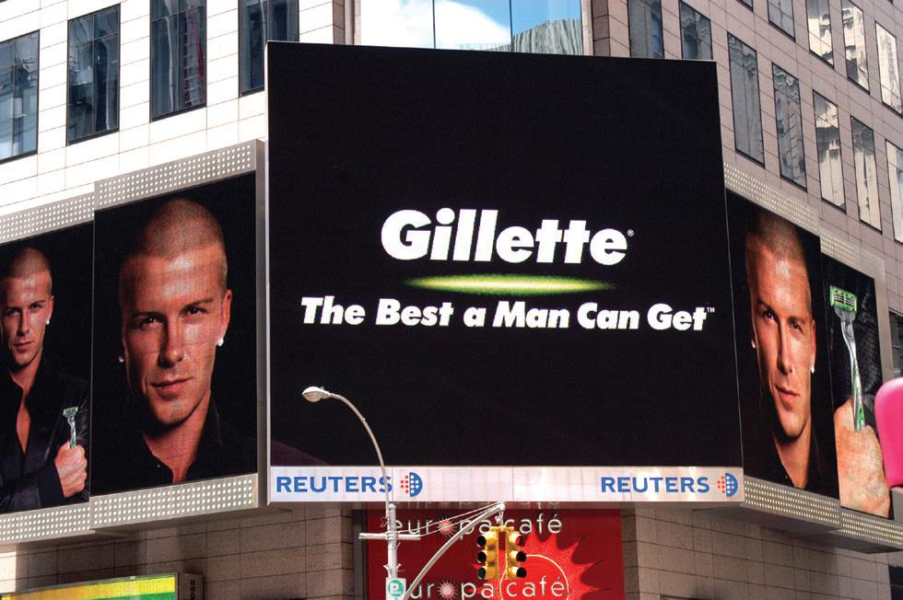
Global Products and Brands (1 of 2)
Global products meet the wants and needs of a global market and are offered in all world regions at each stage of development
Global brands have the same name and similar image and positioning throughout the world
B M W : Ultimate Driving Machine
G E: Imagination at Work
Visa: Life takes Visa
Harley-Davidson: An American Legend
In any language Gillette’s trademarked brand promise is easy to understand.

Slide 14
Global Products and Brands (2 of 2)
“A multinational has operations in different countries. A global company views the world as a single country. We know Argentina and France are different, but we treat them the same. We sell them the same products, we use the same production methods, we have the same corporate policies. We even use the same advertising-in a different language, of course.”
- Alfred Zeien, Former Gillette C E O
Notes:
Zeien’s remarks reflect the fact that Gillette creates competitive advantage by marketing global products and utilizing global branding strategies. The company reaps economies of scale associated with creating a single ad campaign for the world and the advantages of executing a single brand strategy.

Slide 15
A Localized View
“We believe strongly that there isn’t a so-called global consumer, at least not when it comes to food and beverages. People have local tastes based on their unique cultures and traditions-a good candy bar in Brazil is not the same as a good candy bar in China. Therefore, decision making needs to be pushed down as low as possible in the organization, out close to the markets. Otherwise, how can you make good brand decisions? A brand is a bundle of functional and emotional characteristics. We can’t establish emotional links with consumers in Vietnam from our offices in Vevey.”
Peter Brabeck-Letmathe, former C E O of Nestlé

Slide 16
Global Brand Characteristics
Quality signal-allows a company to charge premium price in a highly competitive market
Global myth-marketers can use global consumer culture positioning (G C C P) to link the brand identity to any part of the world
Social responsibility-shows how a company addresses social problems
Notes:
Worldwide, consumers, corporate buyers, governments, activists, and other groups associate global brands with three characteristics; consumers use these characteristics as a guide when making purchase decisions.
• Quality signal. Global brands compete fiercely with each other to provide world-class quality. A global brand name differentiates product offerings and allows marketers to charge premium prices.
• Global myth. Global brands are symbols of cultural ideals. As noted in Chapter 7, marketers can use global consumer culture positioning (GCCP) to communicate a brand’s global identity and link that identity to aspirations in any part of the world.
• Social responsibility. Customers evaluate companies and brands in terms of how they address social problems and how they conduct business.

Slide 17
Branding Strategies
Global product = personal stereos
Global brand = Sony Combination or tiered branding allows marketers to leverage a company’s reputation while developing a distinctive identity for a line of products
Sony Walkman
Co-branding features two or more company or product brands
NutraSweet and Coca-Cola
Intel Inside
Notes:
Properly implemented, co-branding can engender customer loyalty and allow companies to achieve synergy. However, co-branding can also confuse consumers and dilute brand equity. The approach works most effectively when the products involved complement each other. Credit card companies were the pioneers, and today it is possible to use cards to earn frequent flyer miles and discounts on automobiles.
Co-branding is a variation on combination branding in which two or more different company or product brands are featured prominently on product packaging or in advertising. When properly implemented, co-branding can engender customer loyalty and allow companies to achieve synergy. When done badly, it can confuse consumers and dilute brand equity. This approach works most effectively when the products involved complement each other. Credit card companies were the pioneers in the co-branding realm, so that today it is possible to use cards to earn frequent flyer miles and discounts on automobiles. Another well-known example of co-branding is the Intel Inside campaign promoting both the Intel Corporation and its Pentium-brand processors in conjunction with advertising for various brands of personal computers.

Slide 18
Brand Extension
Brand acts as an umbrella for new products
Example: The Virgin Group
Virgin Active
Virgin Mega-stores, Virgin Books
Virgin Wine
Virgin Radio
Virgin Pure (water purification)
Virgin Health
Virgin Hotels, Virgin Casinos
Virgin Vacations, Virgin Balloon Holidays, Virgin Galactic, Virgin Trains
Notes:
The brand has been built on Richard Branson’s shrewd ability to exploit weaknesses in competitors’ customer service skills, as well as a flair for self-promotion. Branson’s business philosophy is that brands are built around reputation, quality, innovation, and price rather than image. Although Branson is intent on establishing Virgin as the British brand of the new millennium, some industry observers wonder if the brand has been spread too thin.
The Virgin Companies listed above are found at virgin.com

Slide 19
Product/Brand Matrix
Table 10-1 Product/Brand Matrix for Global Marketing.
Blank | Blank | Product | Product
Blank | Blank | Local | Global
Brand | Local | 1. Local product/local brand | 2. Global product/local brand
Brand | Global | 3. Local product/global brand | 4. Global product/global brand
Notes:
This table shows the four combinations of local and global products and brands in matrix form. Each represents a different strategy; a global company can use one or more strategies as appropriate. Some global companies pursue strategy 1 by developing local products and brands for individual country or regional markets. Coca-Cola makes extensive use of this strategy; Georgia canned coffee in Japan is one example. Coca-Cola’s flagship cola brand is an example of strategy 4. In South Africa, Coca-Cola markets Valpre brand bottled water (strategy 2). The global cosmetics industry makes extensive use of strategy 3; the marketers of Chanel, Givenchy, Clarins, Guerlain, and other leading cosmetics brands create different formulations for different regions of the world. However, the brand name and the packaging may be uniform everywhere.

Slide 20
World’s Most Valuable Brands, 2017
Table 10-2 The World’s Most Valuable Brands
Rank | Value ($millions)
Apple | 184,154
Google | 141,703
Microsoft | 79,999
Coca-Cola | 69,733
Amazon | 64,796
Samsung | 56,249
Toyota | 50,291
Facebook | 48,188
Mercedes | 47,829
I B M | 46,829
Notes:
Table 10-2 shows global brands ranked in terms of their economic value as determined by analysts at the Interbrand consultancy and Citigroup. To be included in the rankings, the brand has to generate approximately one-third of sales outside the home country; brands owned by privately held companies, such as Mars, are not included. Not surprisingly, technology giants Apple and Google occupy the top two spots. Coincidentally, Google also ranked number 3 in the 2017 Global
Brand Simplicity Index compiled by Siegel+Gale; German discounter Aldi topped the rankings.

Slide 21
Global Brand Development (1 of 4)
Questions to ask when management seeks to build a global brand:
Does this move fit the company and/or its markets?
Will anticipated scale economies materialize?
How difficult will it be to develop a global brand team?
Can a single brand be imposed on all markets successfully?
Notes:
Aacker and Joachimsthaler’s research

Slide 22
Global Brand Development (2 of 4)
Global Brand Leadership
Using organizational structures, processes, and cultures to allocate brand-building resources globally, to create global synergies, and to develop a global brand strategy that coordinates and leverages country brand strategies
Notes:
Companies should place a priority on creating strong brands in all markets through global brand leadership.

Slide 23
Global Brand Development (3 of 4)
Create a compelling value proposition, beginning with the home-country market.
Think about all elements of brand identity and select names, marks, and symbols that have the potential for globalization.
Develop a company-wide communication system to share & leverage knowledge and information about marketing programs & customers in different markets.
Notes:
Both this slide and the next offer six suggestions for managers that are seeking to develop global brand leadership.

Slide 24
Global Brand Development (4 of 4)
Develop a consistent planning process across markets & products. Make a process template available to managers in all markets.
Assign specific responsibility for managing branding issues to ensure local brand managers accept global best practices.
Execute brand-building strategies that leverage global strengths & respond to relevant local differences.
Notes:
Coke is arguably the quintessential global product and global brand. Coke relies on similar positioning and marketing in all countries; it projects a global image of fun, good times, and enjoyment. The product itself, though, may vary to suit local tastes; for example, Coke increased the sweetness of its beverages in the Middle East, where customers prefer a sweeter drink. Also, prices may vary to suit local competitive conditions, and the channels of distribution may differ. In 2009, Coke adopted the global advertising theme “Open Happiness.” The previous slogan, “The Coke Side of Life,” was also global but required adaptation in emerging markets such as Russia and China. However, the basic, underlying strategic principles that guide the management of the brand are the same worldwide. The issue is not exact uniformity but rather: Are we offering essentially the same product and brand promise? As discussed in the next few chapters, other elements of the marketing mix—for example, price, communications appeal and media strategy, and distribution channels—may also vary.

Slide 25
A Needs-Based Approach to Product Planning
Maslow’s Needs Hierarchy helps marketers understand how & why local products go beyond the home-country
Needs and wants aren’t the same thing
Global giants like Coca-Cola, McDonald’s, and Sony understand and build local products or products that fulfill social functions
Notes:
At the most basic level of human existence, physiological and safety needs must be met. People need food, clothing, and shelter, and a product that meets these basic needs has potential for globalization.
However, the basic human need to consume food and drink is not the same thing as wanting or preferring a Big Mac or a Coke. Before the Coca-Cola Company and McDonald’s conquered the world, they built their brands and business systems at home. Because their products fulfilled basic human needs and because both companies are masterful marketers, they were able to cross geographic boundaries and build global brand franchises. At the same time, Coca-Cola and McDonald’s have learned from experience that some food and drink preferences—China is a case in point—remain deeply embedded in culture. Responding to those differences has meant creating local products and brands for particular country markets. Sony has prospered for a similar reason. Audio and video entertainment products fulfill important social functions. Throughout its history, Sony’s corporate vision has called for developing new products such as the transistor radio and the Walkman personal stereo that fulfill the need for mobile entertainment.

Slide 26
Maslow’s Hierarchy of Needs
Figure 10-1 Maslow’s Hierarchy of Needs
Notes:
The essence of marketing is finding needs and filling them. Maslow’s hierarchy of needs, a staple of sociology and psychology courses, provides a useful framework for understanding how and why local products and brands can be extended beyond home country borders. Maslow hypothesized that people’s desires can be arranged into a hierarchy of five needs. As an individual fulfills needs at each level, he or she progresses to higher levels. At the most basic level of human existence, physiological and safety needs must be met. People need food, clothing, and shelter, and a product that meets these basic needs has potential for globalization. Mid-level needs in the hierarchy include self-respect, self-esteem, and the esteem of others. These social needs, which can create a powerful internal motivation driving demand for status-oriented products, cut across the various stages of country development.
Rolex, Louis Vuitton, and Dom Perignon are just a few of the global brands that consumers buy in an effort to satisfy esteem needs. Some consumers flaunt their wealth by buying expensive products and brands that others will notice. Such behavior is referred to as conspicuous consumption or luxury badging.
Note: Luxury brands are doing exceptionally well thanks to the growth of millionaires in China and India and the demands they have for such goods.

Slide 27
Asian Hierarchy of Needs
Figure 10-2 Maslow’s Hierarchy: The Asian Equivalent
Notes:
Hellmut Schütte has proposed a modified hierarchy to explain the needs and wants of Asian consumers. Although the two lower-level needs are the same as in the traditional hierarchy, the three highest levels emphasize social needs. Affiliation needs in Asia are satisfied when an individual has been accepted by a group. Conformity with group norms becomes a key force driving consumer behavior. For example, when a cool new cell phone hits the market, every teenager who wants to fit in buys one. Knowing this, managers at Japanese companies develop local products specifically designed to appeal to teens. The next level is admiration, a higher-level need that can be satisfied through acts that command respect within a group. At the top of the Asian hierarchy is status, the esteem of society as a whole. In part, attainment of high status is character driven. However, the quest for status also leads to luxury badging. Support for Schütte’s contention that status is the highest-ranking need in the Asian hierarchy can be seen in the geographic breakdown of the $200-plus billion global luxury goods market. Fully 20 percent of industry sales are generated in Japan alone, with another 22 percent of sales occurring in the rest of the Asia-Pacific region. Nearly half of all sales revenues of Italy’s Gucci Group are generated in Asia.

Slide 28
Country of Origin as Brand Element
Perceptions about and attitudes toward particular countries often extend to products and brands known to originate in those countries
Japan
United States
Finland
Italy
Notes:
One of the facts of life in global marketing is that perceptions about and attitudes toward particular countries often extend to products and brands known to originate in those countries. Such perceptions contribute to the country-of-origin effect; they become part of a brand’s image and contribute to brand equity. This is particularly true for automobiles, electronics, fashion, beer, recorded music, and certain other product categories. Perceptions and attitudes about a product’s origins can be positive or negative. On the positive side, as one marketing expert has pointed out, “‘German’ is synonymous with quality engineering, ‘Italian’ is synonymous with style, and ‘French’ is synonymous with chic.”
English tea
French perfume
Jamaican rum
Chinese silk
Italian leather
Japanese electronics
USA: Polo, Land’s End, Budweiser, Marlboro
Korea: LG, Hyundai, Daewoo, Samsung

Slide 29
Extend, Adapt, Create: Strategic Alternatives in Global Marketing
Extension - offering product virtually unchanged in markets outside of home country
Adaptation - changing elements of design, function, and packaging according to needs of different country markets
Product Invention - developing new products for the world market
Notes:
Laws and regulations in different countries frequently lead to obligatory product design adaptations. This may be seen most clearly in Europe, where one impetus for the creation of the single market was the desire to dismantle regulatory and legal barriers that prevented pan-European sales of standardized products. These were particularly prevalent in the areas of technical standards and health and safety standards. In the food industry, for example, there were 200 legal and regulatory barriers to cross-border trade within the EU in 10 food categories.

Slide 30
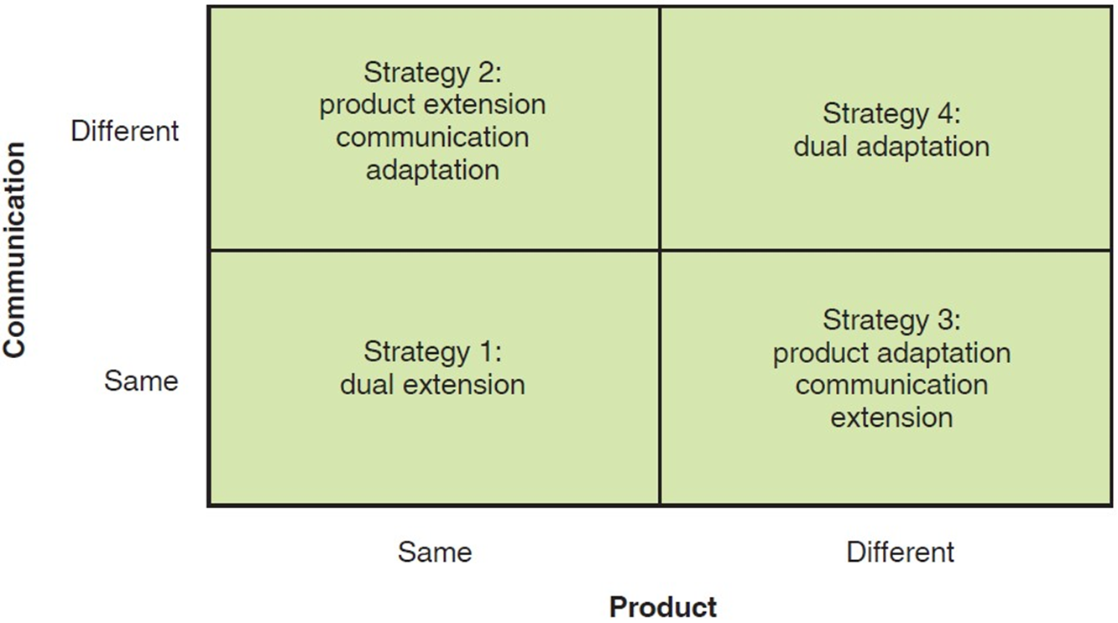
Global Product Planning: Strategic Alternatives
Figure 10-3 Global Product Planning: Strategic Alternatives
Notes:
Extension strategies are employed by companies in the international, global, and transnational stages of development. The critical difference is one of execution and mind-set. In an international company, for example, the extension strategy reflects an ethnocentric orientation and the assumption that all markets are alike. A global company such as Gillette does not fall victim to such assumptions; the company’s geocentric orientation allows it to thoroughly understand its markets and consciously take advantage of similarities in world markets. Likewise, a multinational company utilizes the adaptation strategy because of its polycentric orientation and the assumption that all markets are different. By contrast, the geocentric orientation of managers and executives in a global company has sensitized them to actual, rather than assumed, differences between markets.
Strategy 1: Common for B2B
Strategy 2: Low-cost because the product is unchanged, communication is adapted
Strategy 3: For many years, Ford sold the Escort, Focus, and other nameplates worldwide, though the vehicles themselves often varied from region to region. In 2010, Ford launched a new Focus model in the United States that has 80 percent shared content with the European Focus. The 20 percent adapted content reflects regulations such as bumper crash test standards
Strategy 4: Combines local market conditions recognized in Strategies 2 and 3

Slide 31
Strategy 1: Dual Extension
Product-Communication Extension
May be very profitable, simple
Almost no adaptation
Same advertising and promotional appeals
Used with B 2 B or industrial products
Apple iPhone
Loctite adhesives
Notes:
As a general rule, extension/standardization strategies are utilized more frequently with industrial (business-to-business) products than with consumer products. The reason is simple: Industrial products tend to be less deeply rooted in culture than are consumer goods.
Apple launched its iPhone in the United States in mid-2007. In the following months, this product was gradually rolled out in several more markets, including France and the United Kingdom. When Apple brought its second-generation iPhone to market 1 year later, it was launched in 21 countries simultaneously. Henkel KGaA markets its Loctite-brand family of adhesive products globally using the dual-extension strategy (see Exhibit 10-9). The company’s various lines—including medical adhesives and threadlockers—bear the Loctite brand name. Ads also include the Henkel corporate logo.

Slide 32
Strategy 2: Product Extension-Communications Adaptation
Products may serve the same or different needs in different markets
No product changes reduce expense
Costs in market research advertising, sales promotion, point-of-sale material
Ex. Miller Genuine Draft is an international lifestyle brand (G C C P) in Central Europe rather than an American brand (F C C P)
Ben & Jerry’s changed packaging color in the U.K.
John Deere tractors designed for India were marketed to hobby farmers in the U.S.
Notes:
Marketers of premium American bourbon brands such as Wild Turkey have found that images of Delta blues music, New Orleans, and Route 66 appeal to upscale drinkers outside the United States. However, images that stress bourbon’s rustic, backwoods origins do not necessarily appeal to Americans. As Gary Regan, author of The Book of Bourbon, has noted, “Europeans hate Americans when they think of them as being the policemen of the world, but they love Americans
when they think about blue jeans and bourbon and ranches.”
Jägermeister schnapps is marketed differently in different key country markets. Chief executive Hasso Kaempfe believes that a diversity of images has been a key element in the success of Jägermeister outside of Germany, where the brown, herb-based concoction originated. In the United States, Jägermeister was “discovered” in the mid-1990s by the college crowd. Kaempfe’s marketing team has capitalized on the brand’s cult status by hiring “Jägerettes,” girls who pass out free samples; the company’s popular T-shirts and orange banners are also distributed at rock concerts. By contrast, in Italy, the brand’s second-largest export market, Jägermeister is considered an up-market digestive to be consumed after dinner. In Germany, Austria, and Switzerland, where beer culture predominates, Jägermeister and other brands of schnapps have more traditional associations as a remedy for coughs, stomach aches, or as a “morning after” elixir.

Slide 33
Strategy 3: Product Adaptation-Communications Extension
Adapt the product to local use but the message stays the same
Cadillac B T S in Sweden is
shorter that the C T S;
available in diesel
Oreos in China failed until they were reformulated to be less sweet and expensive
Notes:
When Kraft Foods launched Oreo brand cookies in China in 1996, it used a product extension approach. Following several years of flat sales, Kraft’s in-country marketing team launched a research study, which alerted the team to the fact that Oreos were too sweet for the Chinese palate and that the price—14 cookies for 72 cents—was too high. Oreos were then reformulated as a less-sweet, chocolate-covered, four-layer wafer filled with vanilla and chocolate cream. Packages of the new wafer Oreo contain fewer cookies but sell for about 29 cents. Today, Oreo is the best-selling cookie brand in China.

Slide 34
Strategy 4: Product-Communications Adaptation
Dual Adaptation
Both may need to change for legal, cultural, or other environmental reasons
Regional managers may simply act independently
Nike global shoes and “Just Do It” approach didn’t work in China
Less expensive shoes created in country and ads featuring Chinese athletes in line with cultural principles of harmony and respect for authority
Notes:
Nike has built a global brand by marketing technologically advanced, premium-priced athletic shoes in conjunction with advertising that emphasizes U.S.-style, in-your-face brashness and a “Just Do It” attitude. In the huge and strategically important China market, however, this approach had several limitations. For one thing, Nike’s “bad boy” image is at odds with ingrained Chinese values such as respect for authority and filial piety. As a general rule, Nike advertisements in China do not show disruption of harmony; this is due, in part, to a government that discourages dissent. Price was another issue: A regular pair of Nike shoes cost the equivalent of $60–$78, while average annual family income ranges from about $200 in rural areas to $500 in urban areas. In the mid-1990s, Nike responded by creating a shoe that could be assembled in China specifically for the Chinese market using less expensive material and sold for less than $40. After years of running ads designed for Western markets by longtime agency Wieden & Kennedy, Nike hired Chinese-speaking art directors and copywriters working in WPP Group’s J. Walter Thompson ad agency in Shanghai to create new advertising featuring local athletes that would appeal to Chinese nationalistic sentiments.

Slide 35
Strategy 5: Innovation
Important for reaching mass markets in less industrialized nations and certain segments in industrialized countries
Instant Eyeglasses
Hand-cranked radios for areas with no electricity
Thermax, an Indian producer of small industrial boilers, created new products for industrialized countries
Notes:
Thermex had achieved great success in the domestic market. A new design focused on ease of installation., a factor not important in low-wage India but extremely important in industrialized nations.
As an example of how innovation can be applied to meet the needs of low-income populations, consider two entrepreneurs, working independently, who recognized that millions of people around the globe need low-cost eyeglasses. Robert J. Morrison, an American optometrist, created Instant Eyeglasses. These glasses utilize conventional lenses, can be assembled in minutes, and sell for approximately $20 per pair. Joshua Silva, a physics professor at Oxford University, took a
more high-tech approach and came up with glasses with transparent membrane lenses filled with clear silicone fluid. Using two manual adjusters, users can increase or decrease the power of the lenses by regulating the amount of fluid in them. Professor Silva is currently CEO of the Centre for Vision in the Developing World, whose mission is to sell low-cost, self-adjusting glasses in developing countries.

Slide 36
How to Choose a Strategy?
Managers face two types of errors:
N I H “Not Invented Here” and Ethnocentrism
The product itself, defined in terms of the function or need it serves
The market, defined in terms of the conditions under which the product is used, preferences of potential customers, and ability to buy the product
Adaptation and manufacturing costs the company will incur
Notes:
This slide sums up the section regarding choosing a product-communication strategy. It is important to note that only after analysis of the product-market fit and of company capabilities and costs can executives choose the most profitable strategy.

Slide 37
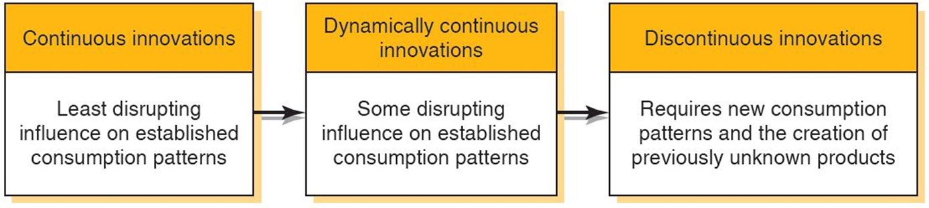
Identifying New Product Ideas
Figure 10-4 New-Product Continuum
What is a new product?
New to those who use it or buy it
New to the organization
New to a market
Notes:
The starting point for an effective worldwide new-product program is an information system that seeks new-product ideas from all potentially useful sources and channels these ideas to relevant screening and decision centers within the organization. Ideas can come from many sources, including customers, suppliers, competitors, company salespeople, distributors and agents, subsidiary executives, headquarters executives, documentary sources (e.g., information service reports and publications), and, finally, actual firsthand observation of the market environment. The diagram on this slide illustrates the continuum that new products will fall into and the amount of learning that consumers will have to go through in order to use the product.
Continuous innovations = “new and improved;” less R&D needed; a faster computer. May be in the form of line extension
Dynamically continuous innovations = require less learning and is less disruptive; Gillette Sensor, Sensor Excel, and MACH3 brings news technology for an unchanged category, wet shaving; Music on the go 1050s transistor radios to Sony Walkman; TVs to high def, flat screen products
Discontinuous innovations = represent a break with the past; VCRs, PCs, Apple products: iPod, iPhone, iPad

Slide 38
The International New Product Department
How big is the market for this product at various prices?
What are the likely competitive moves in response to our activity?
Can we market the product through existing structure?
Can we source the product at a cost that will yield an adequate profit?
Does product fit our strategic development plan?
Notes:
A high volume of information flow is required to scan adequately for new-product opportunities, and considerable effort is subsequently required to screen these opportunities to identify candidates for product development. The best organizational design for addressing these requirements is a new product department. Managers in such a department engage in several activities. First, they ensure that all relevant information sources are continuously tapped for new-product ideas. Second, they screen these ideas to identify candidates for investigation. Third, they investigate and analyze selected new-product ideas. Finally, they ensure that the organization commits resources to the most likely new-product candidates and is continuously involved in an orderly program of new-product introduction and development on a worldwide basis.
1. How big is the market for this product at various prices?
2. What are the likely competitive moves in response to our activity with this product?
3. Can we market the product through our existing structure? If not, what changes will be required, and what costs will be incurred to make the changes?
4. Given estimates of potential demand for this product at specified prices and estimated levels of competition, can we source the product at a cost that will yield an adequate profit?
5. Does this product fit our strategic development plan? (a) Is the product consistent with our overall goals and objectives? (b) Is the product consistent with our available resources? (c) Is the product consistent with our management structure? (d) Does the product have adequate global potential?

Slide 39
Testing New Products
When do you test a new product?
Whenever a product interacts with human, mechanical, or chemical elements because there is the potential for a surprising and unexpected incompatibility
Test could simply be observing the product being used within the market
Notes:
Failure to assess actual use conditions can lead to big surprises, as Unilever learned when it rolled out a new detergent brand in Europe without sufficient testing. Unilever spent $150 million to develop the new detergent, which was formulated with a stain-fighting manganese complex molecule intended to clean fabrics faster at lower temperatures than competing products such as Procter & Gamble’s Ariel. Backed by a $300 million marketing budget, the detergent was launched in April 1994 as Persil Power, Omo Power, and other brand names. After a restructuring, Unilever had cut the time required to roll out new products in Europe from 3 years to 16 months. In this particular instance, the increased efficiency combined with corporate enthusiasm for the new formula resulted in a marketing debacle. Consumers discovered that some clothing items were damaged after being washed with Power. P&G, quick to capitalize on the situation, ran newspaper ads denouncing Power and commissioned lab tests to verify that the damage did, in fact, occur. Unilever chairman Sir Michael Perry called the Power fiasco, “the greatest marketing setback we’ve seen.” Unilever reformulated Power, but it was too late to save the brand. The company lost the opportunity to gain share against P&G in Europe.

Slide 40

Copyright
This work is protected by United States copyright laws and is provided solely for the use of instructors in teaching their courses and assessing student learning. Dissemination or sale of any part of this work (including on the World Wide Web) will destroy the integrity of the work and is not permitted. The work and materials from it should never be made available to students except by instructors using the accompanying text in their classes. All recipients of this work are expected to abide by these restrictions and to honor the intended pedagogical purposes and the needs of other instructors who rely on these materials.

